Slide 1
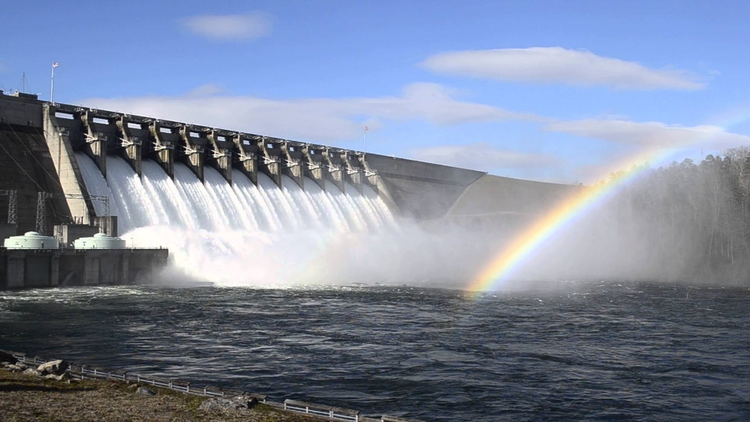
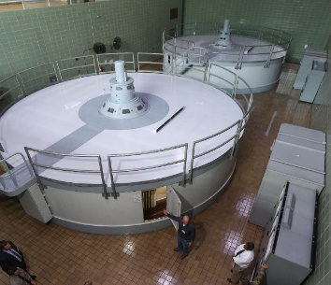
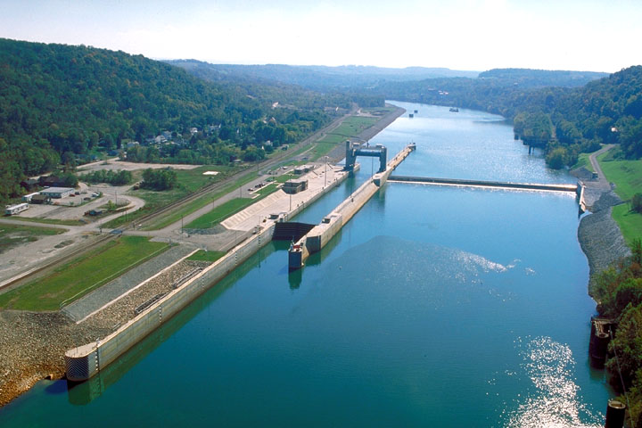
Improving resiliency for Texas, Who has the Responsibility?
By: Jerry Cotter P.E.
Title: Water Resources Branch Chief, Fort Worth District
Date: 28 February 2020
Audience: American Society of Civil Engineers (ASCE), Dallas Chapter February Meeting

Slide 2
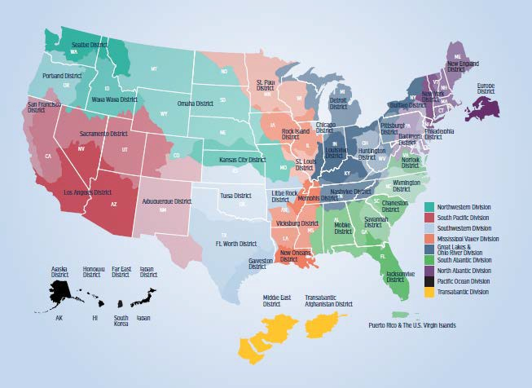
Mission, Vision and Organization
USACE Mission
Deliver vital public and military engineering services; partnering in peace and war to strengthen our Nation’s security, energize the economy and reduce risks from disasters
USACE Vision
Engineering solutions for our Nation’s toughest challenges
Divisions commanded by a General
Districts commanded by a Colonel
Generals and Colonels spend 3 years at each post
Decentralized because of varying missions
Headquarters
9 Divisions
43 Districts
9 Centers and Labs
Countries: 130 of 196
~35k DA Civilians; ~700 Military; ~$40 Billion Budget, ~$5 Billion Civil Works
5

Slide 3
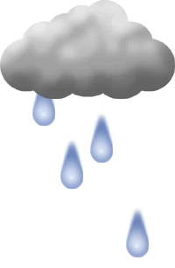
US Army Corps of Engineers
  Compliance! NEPA, Section 10, Section 404, 408 Permits
What We Do
How We Do It
Execute $’s; at the will of the President and Congress; to the benefit of the American People
  Civil works - $7 billion
  Supplemental - $16 billion
  Military Infrastructure - $? billions
  Design/construction for other agencies
  State/Local/Private sector
    Partnerships
    Contracting
    Personnel actions
Authorizations
  Bills, laws
  No work without an authorization
Appropriations
  Annual budget
  No work without an appropriation

Slide 4
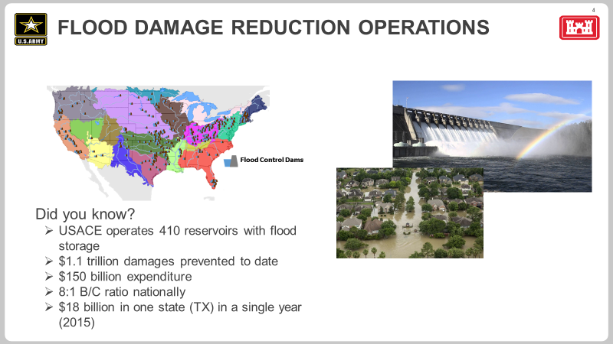
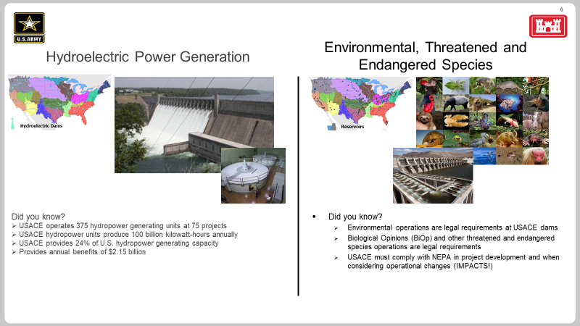
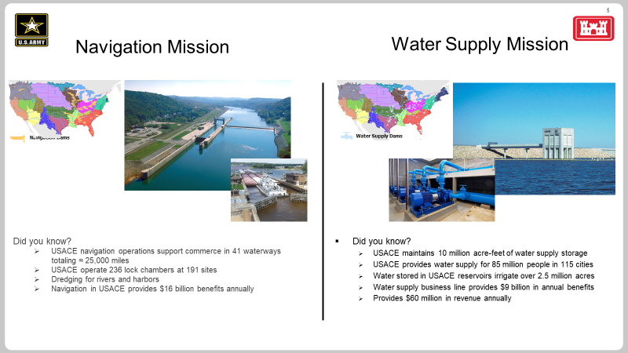
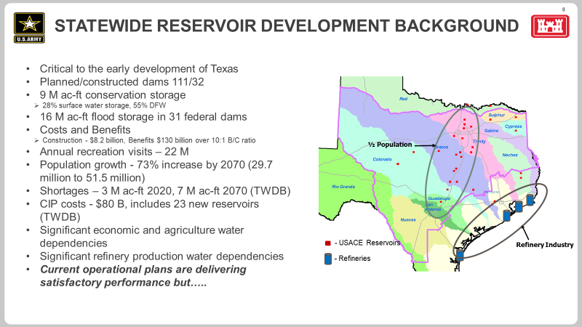
USACE Dam Operations

Slide 5
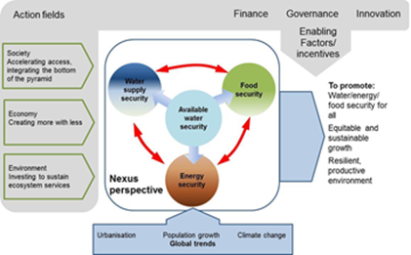
Responsibilities for FPMS and Adaptive Management in WM
Adaptive management is the ability to adjust management or operation of a system based on best available science and acquired knowledge about current conditions and the effects of management actions, as opposed to following a rigid set of rules. Adaptive management, where appropriate and consistent with authorized purposes and applicable law, may provide greater flexibility in system operations to account for the variability and unpredictability of future conditions.
EM 1110-2-1420 – Hydrologic Engineering Requirements for Reservoirs
  2-11 Water Management Goals and Objectives - water control plans should be reviewed and adjusted, as appropriate, to meet changing local conditions, as provided in ER 1110-2-240, Water Control Management. “
  6-7 Climate Change -“Climate change analysis is now required in USACE projects. Climate change should be at least qualitatively considered pending publication of guidance”
ER 1110-2-240 – Water Control Management
  2-3 Policy Requirements for Water Control Management - Within existing authority, operations may be adjusted to better address new or existing authorized purposes. Water control management policies and procedures, including project regulation, shall be evaluated for adaptation to climate change.
  3-1 Water Control Manuals - Water control manuals/plans shall be revised as necessary to conform to changing requirements resulting from developments in the project area and downstream, improvements in technology, improved understanding of ecological response and sustainability, new legislation, and other relevant factors.
ER 1110-2-1941 – Drought Contingency Plans
  5 Policy - Water control managers will conduct recurring reviews of project operations and conditions, and, when appropriate, adjust water control plans/manuals, in response to changing watershed conditions”, includes hydrologic data and climate change
FPMS Authority, Section 206 of the 1960 Flood Control Act
  Foster public understanding of the options for dealing with flood hazards and to promote prudent use and management of the Nation's flood plains. Upon request, program services may be provided to state, regional, and local governments, tribes, and other non-Federal public agencies sometimes free of charge.
Communities
Decisions
Tools, Analysis & Data
Policies & Actions
Foundational Basis
0
USACE/InFRM

Slide 6
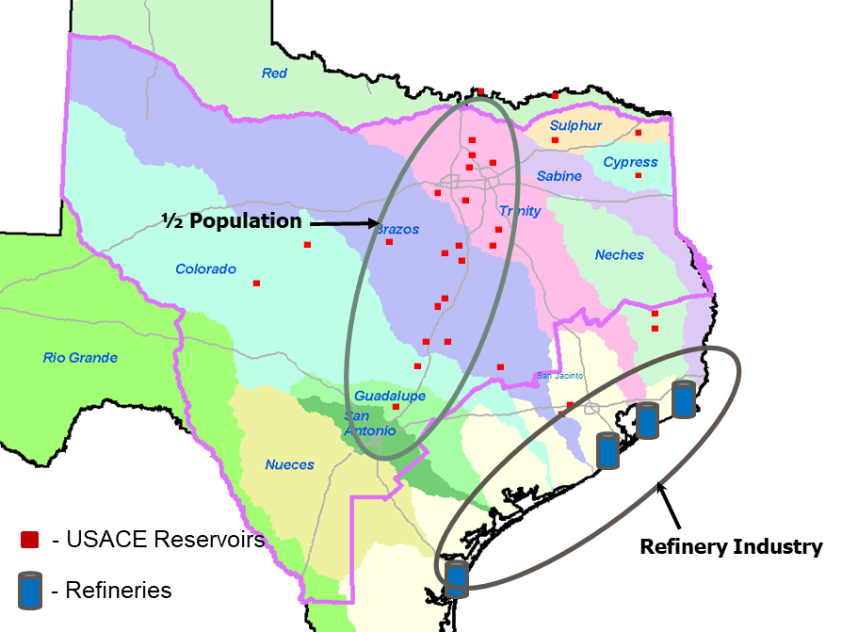
Importance of Water supply and reservoir storage
25 USACE multi-purpose reservoirs
3 watersheds to be considered
6.5 M ac-ft/30% WS storage (55% DFW)
13.4 M ac-ft flood storage
Population growth - 73% increase by 2070 (29.7 million to 51.5 million)
Increasing demand
Shortages – 3 M ac-ft 2020, 7 M ac-ft 2070
CIP costs - $80 B (includes 23 new reservoirs)
Sources are distant
Significant economic and agriculture water dependencies, 2nd largest economy, 3rd agriculture
Petroleum production water dependencies
Notes:
Shot in the arm for Texas
Set the stage for economic growth and development
Provide safe habitable cities
WS benefits not calculated
Close supply
BRA and others move water throughout their basins
Pipelines – E TX to DFW

Slide 7
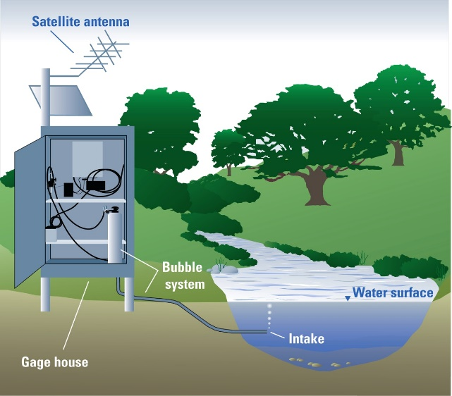
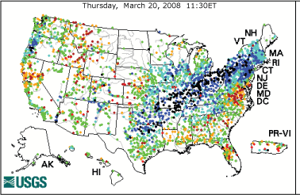
Surface Water Gage Network
Did you know?
  USGS operating partner
    Shared across federal, state and local governments
    $170M national surface water network
    USACE funds about $19.2M
  Provides
    Real-time streamflow and precipitation observations ++
  Highly important for water resources
    Critical for USACE dam operations
    Water Supply
    Flood risk
    Flood operations and public flood warnings
    Trends
    Climate variability and change
    Forms the basis of any regional or national water resources study

Slide 8
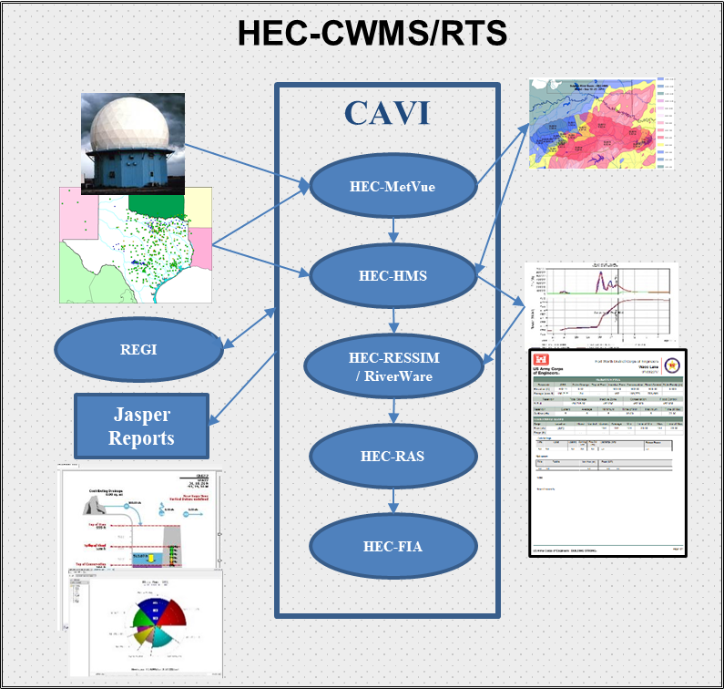
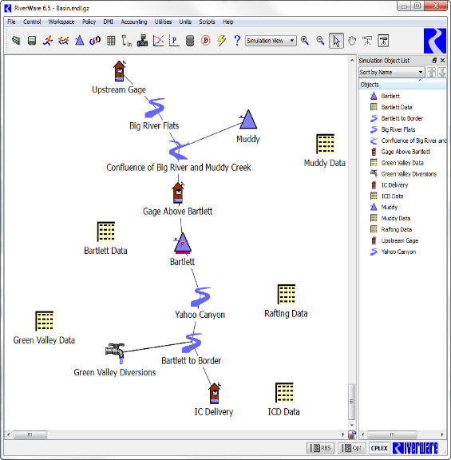
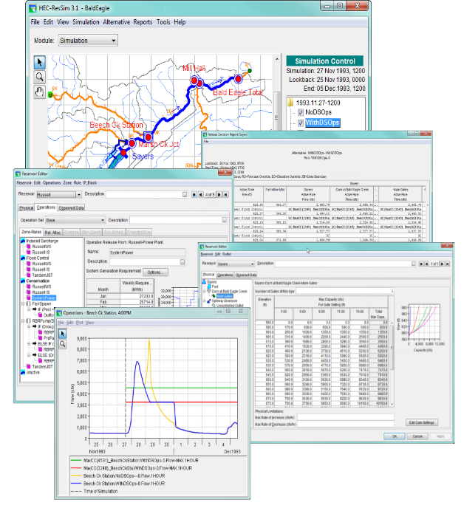
State-of-the-art Technologies
Full suite of software applications for reservoir analysis
      Meteorology (real-time, design storms, shifts)
      Hydrology (basin response)
      Reservoir system simulations, period of record analysis (reservoirs)
      Hydraulics (how deep)
      Consequences (who gets wet and damages)
      Probabilistic, Monte Carlo
Employed across USA and globally
Purposes:
      Planning (WAT)
      Real-time operations (CWMS or RTS)
      Environmental
Watershed studies
      Real-time runoff potential
RiverWare by CADSWES

Slide 9
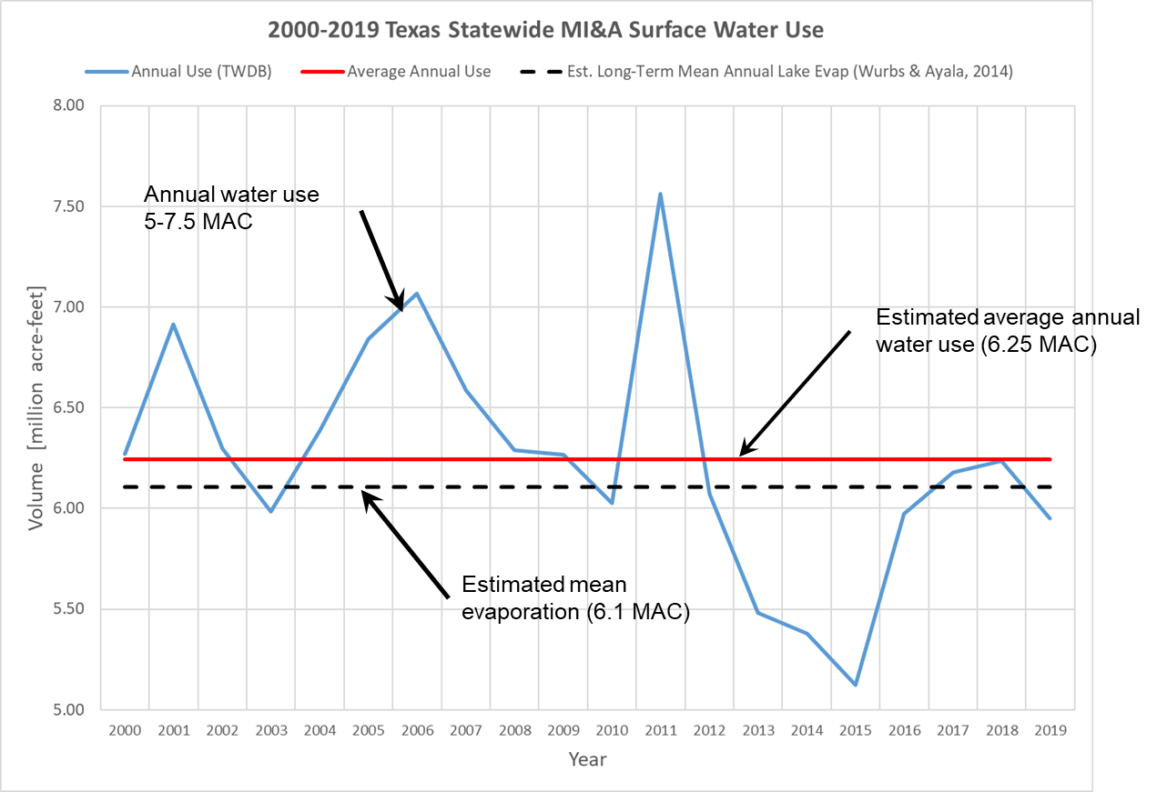
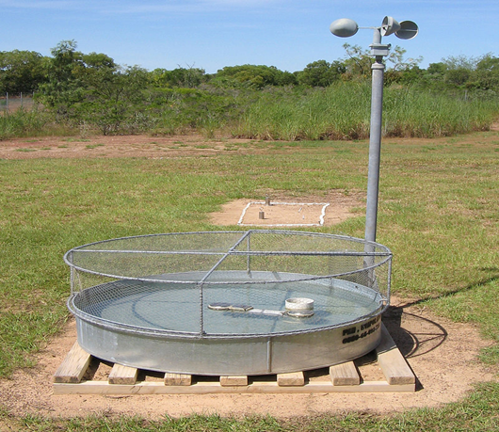
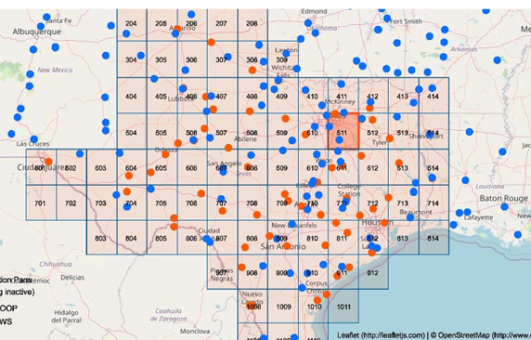
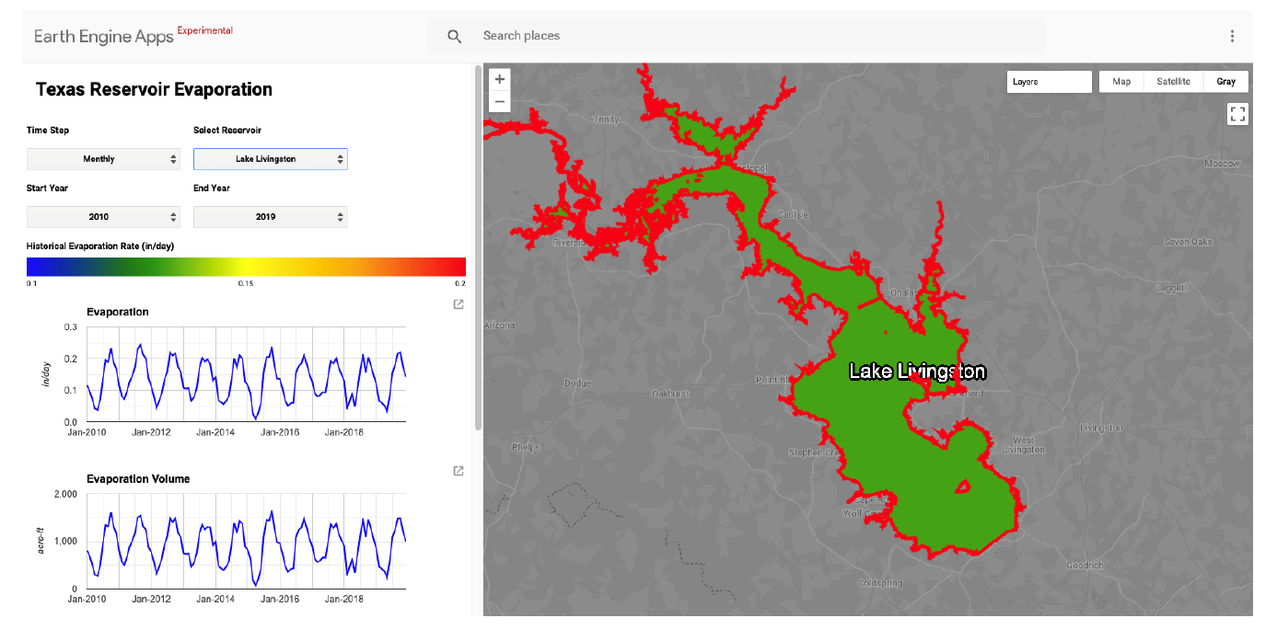
Computed Evaporation for Texas (TWDB, LCRA & USACE)
Texas water availability
  Average annual surface water use is ~ 6.25 MAC
  Average annual evaporation is ~ 6.1 MAC
  Evaporation losses ~ human use
Critical component for determination of water availability
Evaporation pans do not provide ideal evaporation estimates for reservoirs
How will temperature increase impact evaporation
Computed evaporation per research with TXA&M and DRI and use of weather observation data
WEB based application and data base
Evaluation and testing phase
Courtesy TWDB

Slide 10
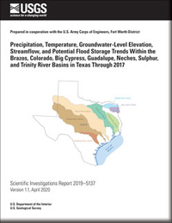
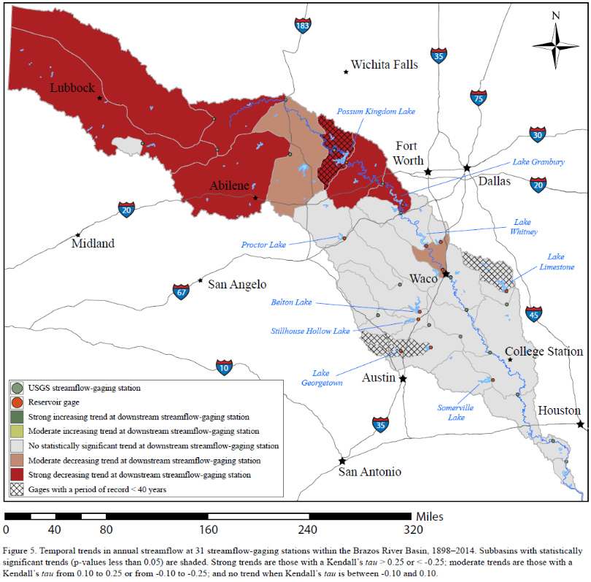
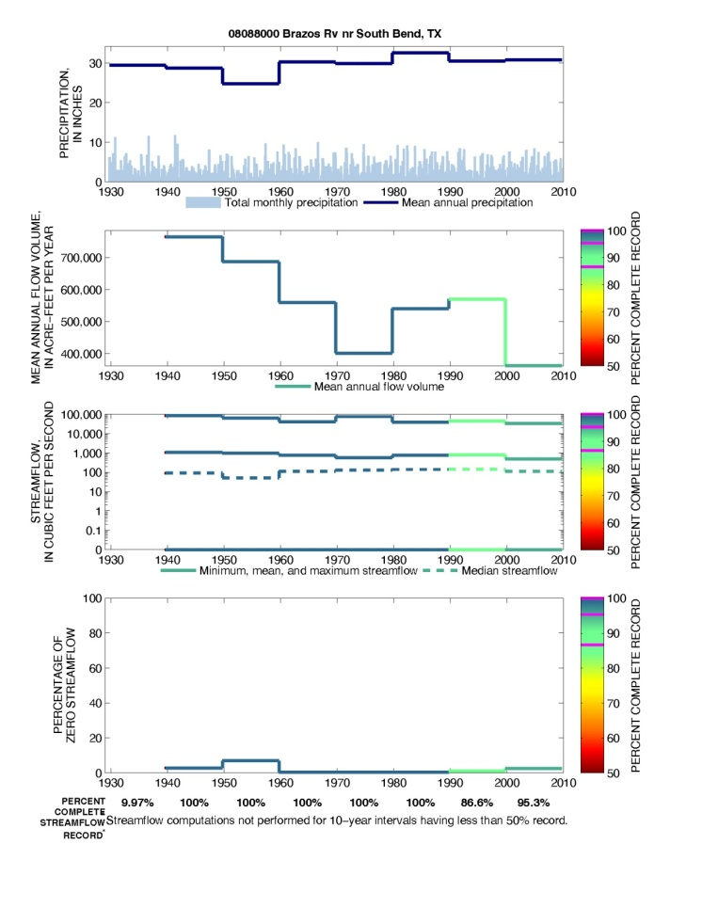
Watershed studies
2019 - Precipitation, Temperature, Groundwater-Level Elevation, Streamflow, and Potential Flood Storage Trends (USGS/USACE Harwell)
    Significant downward trends in water production
    Brazos River
    Colorado River
    Likely related to creation of storage and evaporation associated with large surface areas
2022 Continuing Studies
    Precipitation trends study (USGS/USACE)
    Detailed storage/evap. study for Brazos
Loss rate studies
    Real-time
    Associated with large events

Slide 11

USACE FIRO – What & Benefits?
Pool Allocations
USACE FIRO Space
  2016 ER 1110-2-240, Section 3-3 modification
    “Forecasted conditions may be used for planning future operations…”
  FIRO is, joint R&D effort with 3 thrusts
    Evaluate and improve atmospheric forecasts skill across TX and develop tools
    Explore application of FIRO tools to alter WM decision making
    Modify WCP’s to improve flood risk mgmt., increase water availability and provide ecological benefits
Top of Dam
Top of Flood Control
Flood Storage Pool
Normally: Keep this pool empty!
USACE FIRO Space (5%-15%)
SWF FIRO Potential = 0.3 M – 1 M (ac-ft)
  Lower portion of flood pool (5%-15%)
  Improvements in short-term and mid-range forecasts
  Reservoir studies
  Operational actions involving the use of forecasts
  May be codified within a WCP
Top of Conservation
Conservation Pool
Streambed

Slide 12
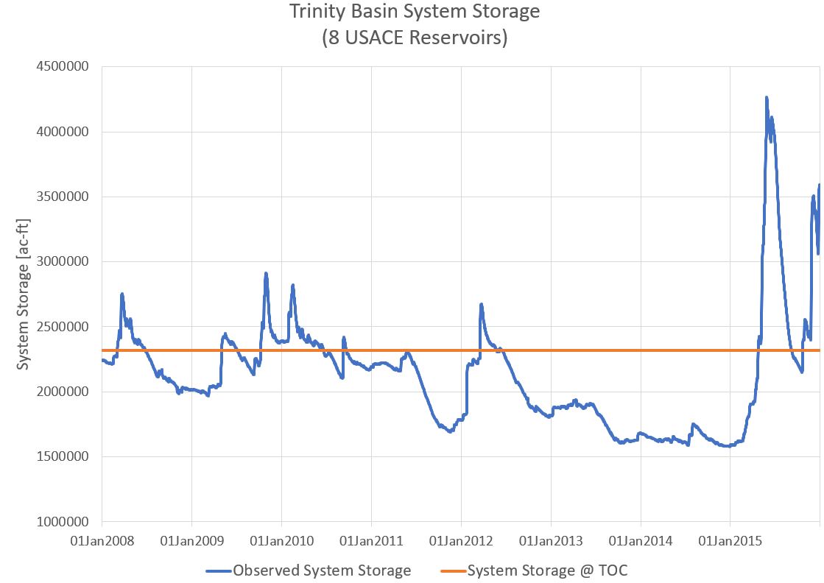
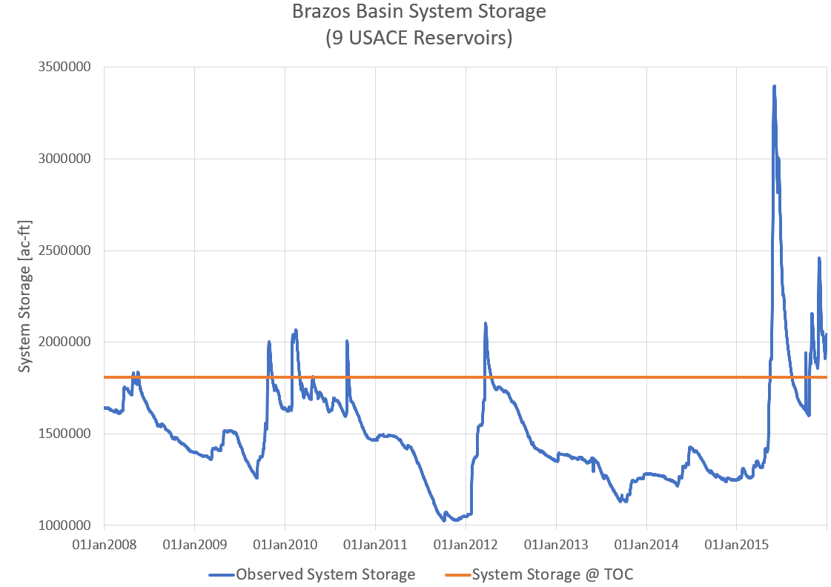
FIRO Benefits – Ideal FIRO Opportunities
More water available without costly infrastructure investments
Storing flood water in late spring and early summer
  Could reduce the need for pumping
Storing runoff that may occur during sequential drought years
Current forecast capability may not support any of these FIRO paradigms
Can we store some of this water?
Can we store some of this water?
Downward Trend
Can we identify the start of this event?
Can we store some of this water?
Can we store some of this water?
Downward Trend
Can we identify the start of this event?
For Official Use Only (FOUO)

Slide 13
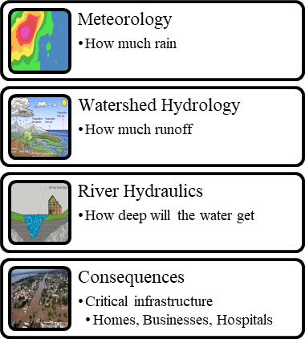
Flood Mitigation and Flood Resiliency

Slide 14
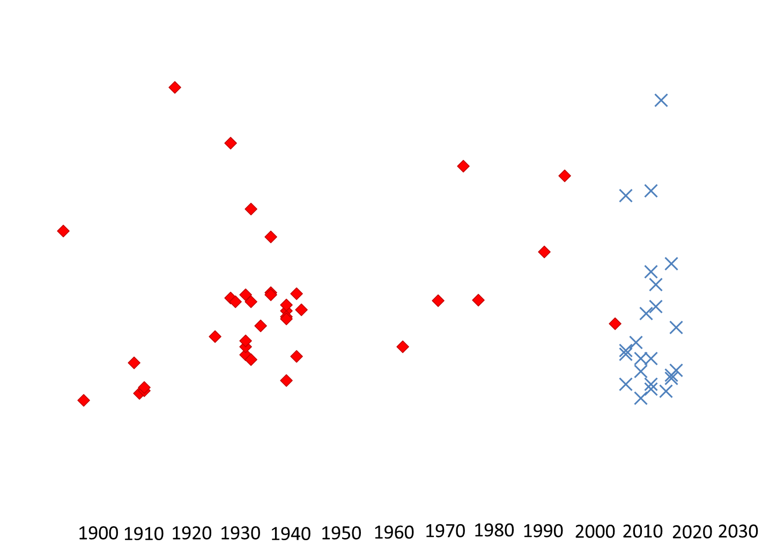
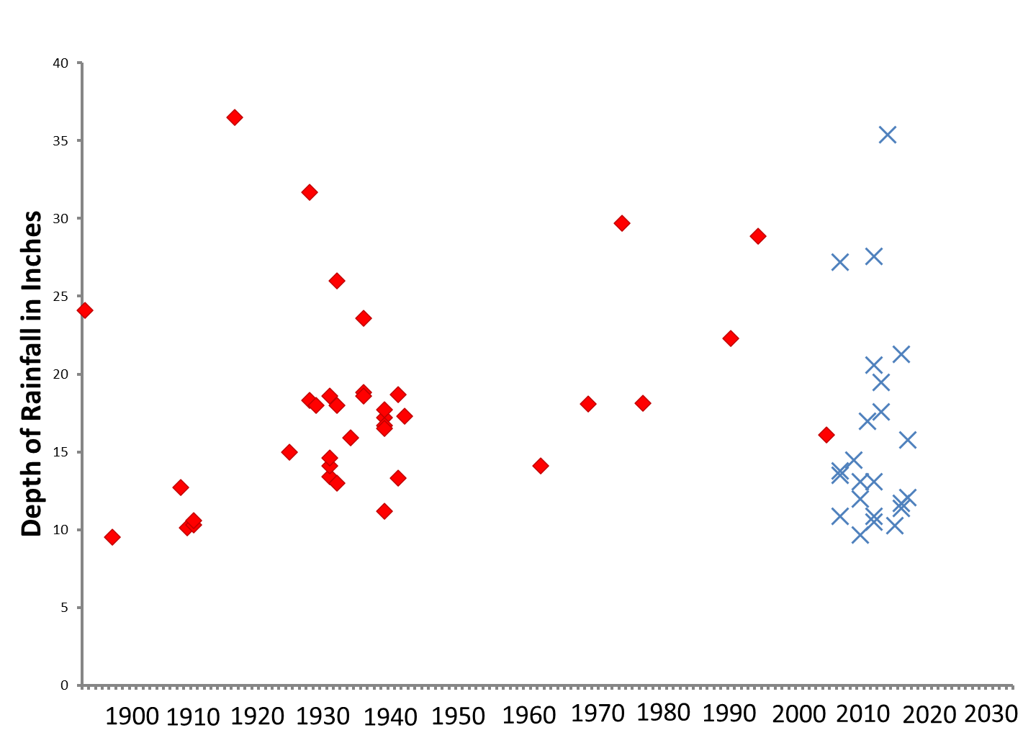
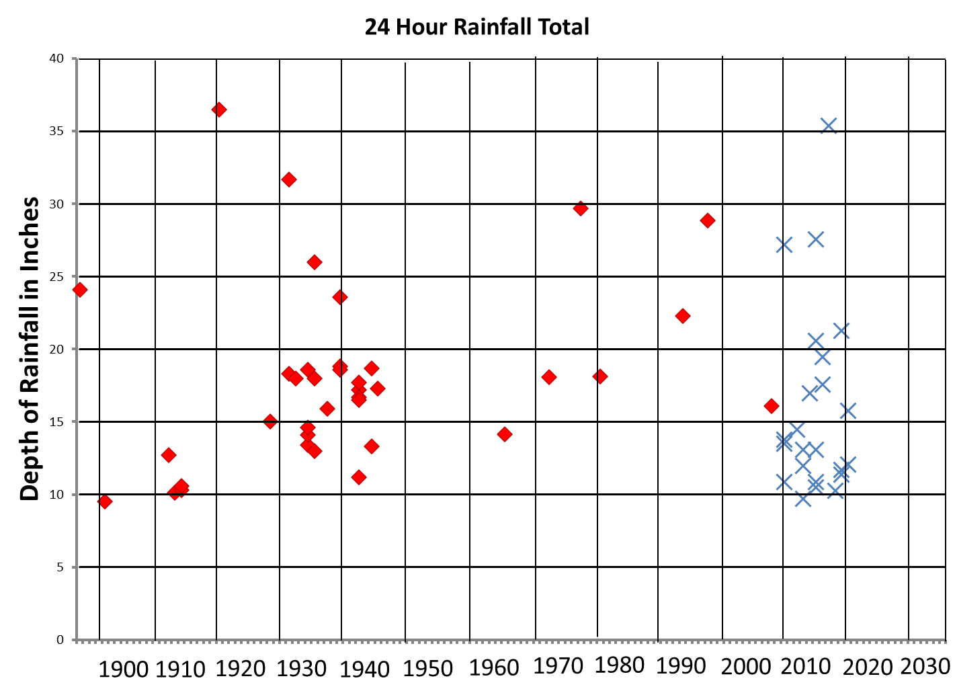
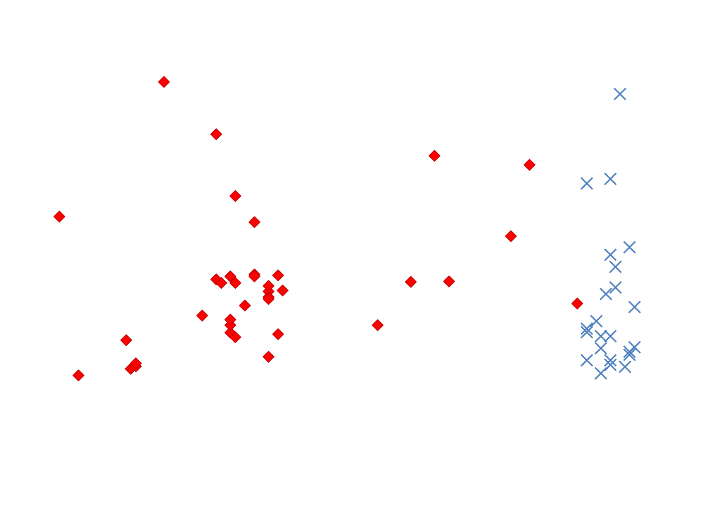
Harvey
Patricia
College Station
NOAA Atlas 14
TP40 Range
TP40 Range
Active Storm Period 1930 - 1945
Less Active Storm Period 1945 - 2009
Extremely Active Storm Period 2009 - Present

Slide 15
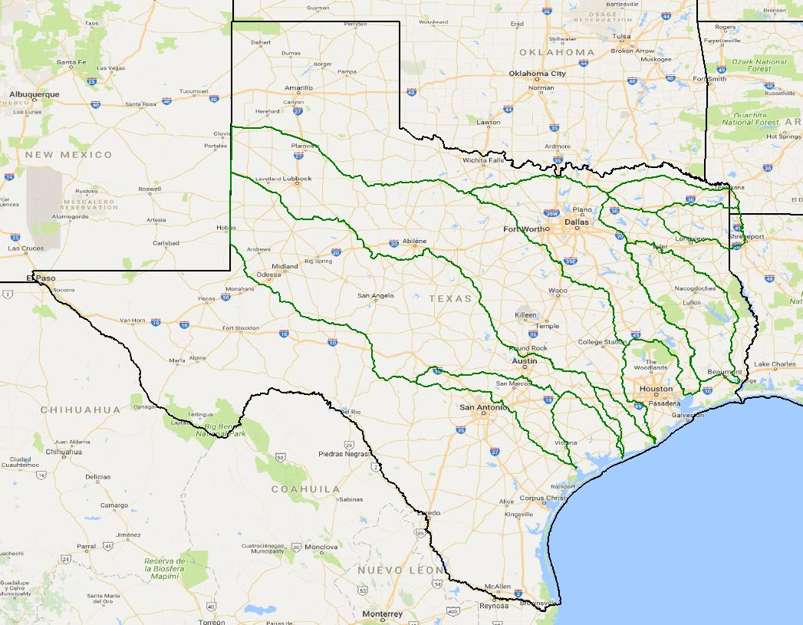
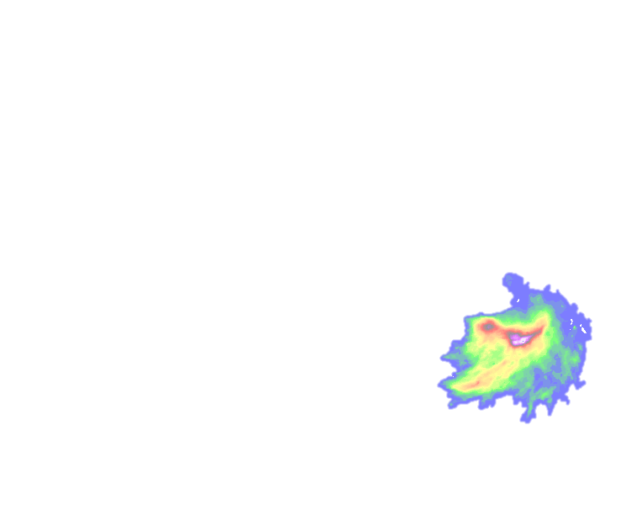
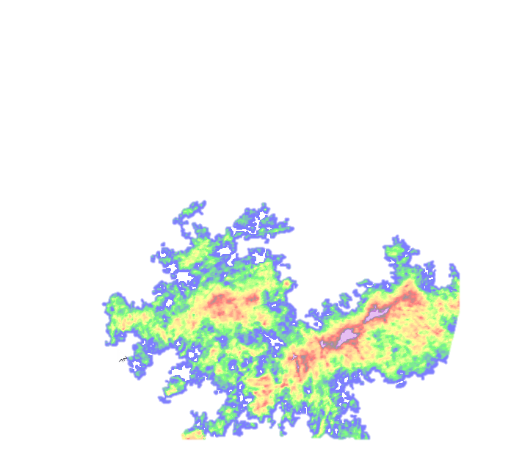
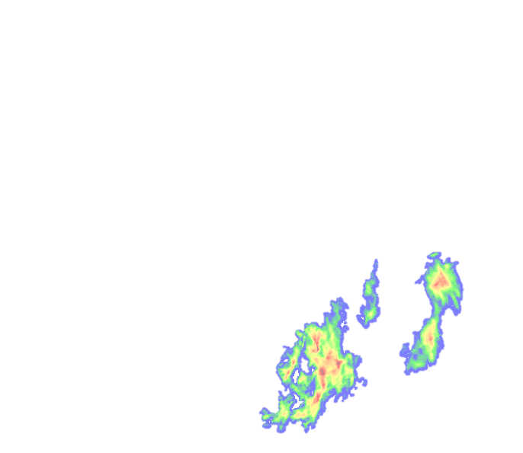
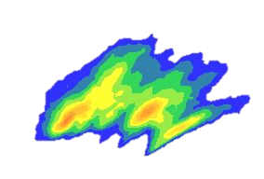
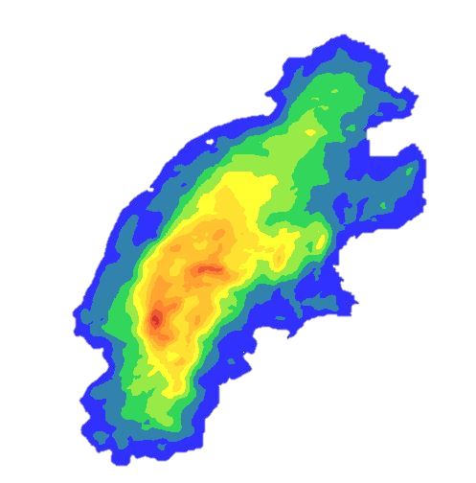
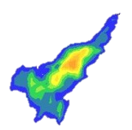
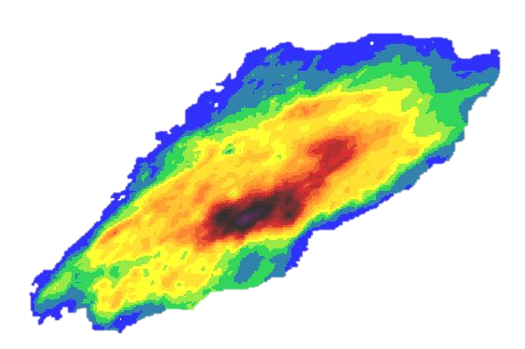
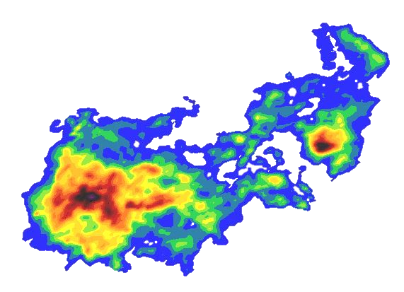
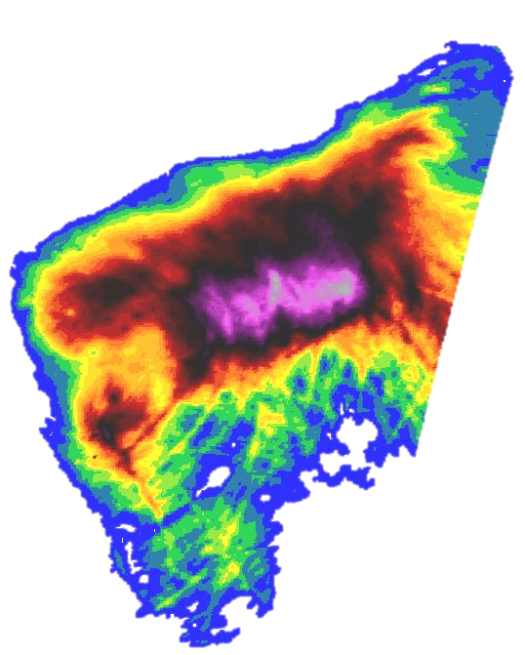
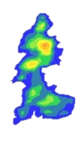
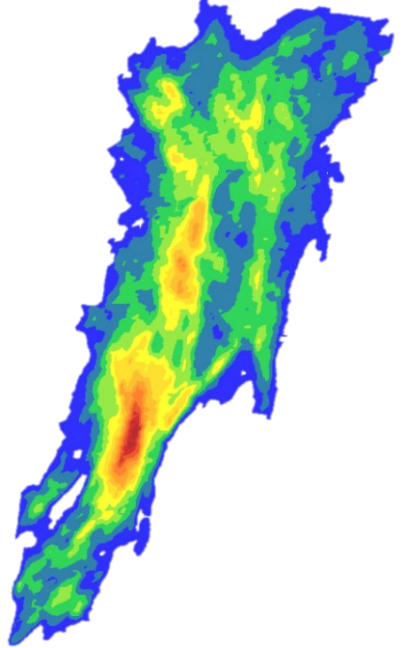
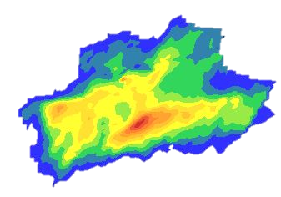
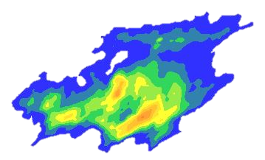
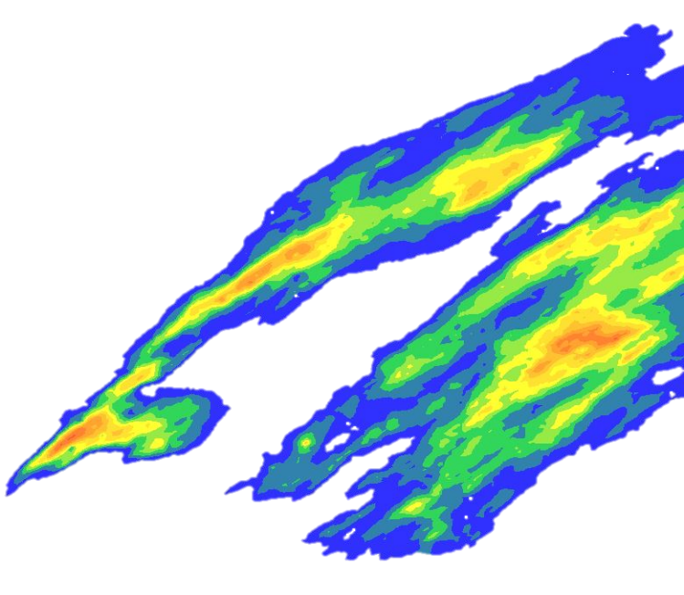
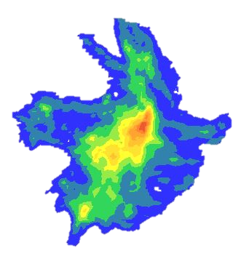
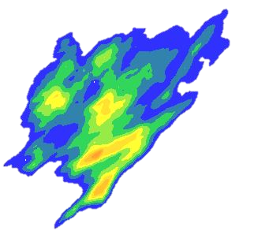
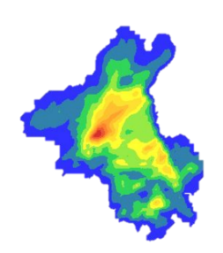
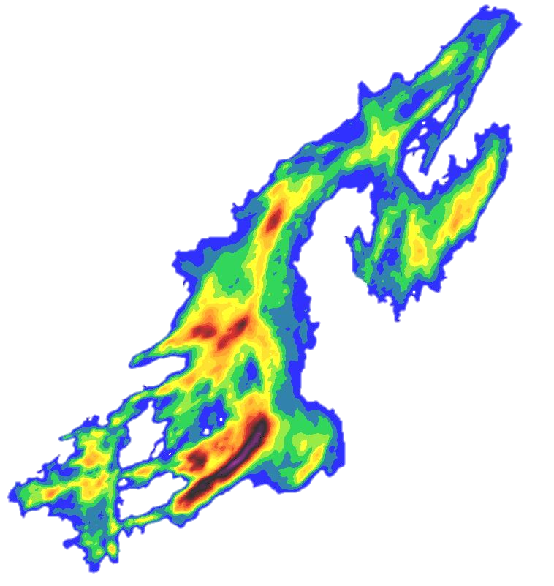
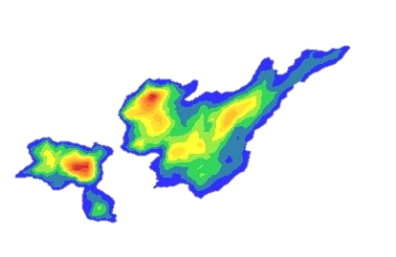







Why - Extreme Storms (2010-2019)

Slide 16




Precipitation STUDIES – How Much Precipitation?
NOAA Atlas 14
Texas storm study
Storm Inventory

Slide 17




Storm Shifting Technologies
What is the hypothetical 100-yr storm?
Are there actual storms that can be classified as a 100-yr storm?
Are there storms greater than the 100-yr storm that we should be concerned about?
How can we make our communities more resilient?
HEC-MetVue, available for free
Leverages Texas Storm Study

Slide 18


Hydrology Studies, Watershed Hydrology Assessments (WHA), How Much runoff?
What is the 100-year (and other frequency) flow (Q)
Consistent regional watershed approach
    All watersheds in TX and others in OK and AR
    Advanced science team using multiple methods
Use of historical observations alone carries unacceptable levels of uncertainty
Partnership, USACE, USGS, NWS, TWDB, GLO
Entire state planned
Will be used for
    Statewide flood mitigation
    NFIP program
    USACE mitigation projects
    Available to all
Loss rate study

Slide 19

River Hydraulics - How Deep?
Flood Decision Support Toolbox (FDST)
    Real-time
    Visualizes current flood-related weather conditions in FEMA region 6 (Arkansas, Louisiana, New Mexico, Oklahoma, Texas),
    Allows analysis (what-if’s) in advance of flood events
    Pre-positioned flood inundation libraries
    Current and future flooding extents
    Can incorporate any communities models
    Limited extent, stream gages and NWS RFC forecast points
Base Level Engineering
    Planning
    Limited detail HEC-RAS hydraulic models for HUC 8 watersheds
    Goals
      Centralized and available flood hazard analysis
      Rapid and extensive coverage
      Benefits
      Allows users to understand their flood risk (High, Moderate, Low) from BLE
      Estimated BFE’s and flood depths for 1% annual chance exceedance floodplain
      Point-click-download access to engineering models and Base Level Engineering datasets.
      Consistent access to flood risk information

Slide 20





TSI Project Summary
  Project Organization: NCTCOG is lead agency for project with subrecipients including (but not limited to) USACE, Tarrant Regional Water District (TRWD), Texas A&M AgriLife, and University of Texas at Arlington (UTA).
  Purpose: Minimize overall life cycle costs, decrease flood risk, and reduce impacts to the natural environment as a result of future population growth in study area.
  Scope: Proactive vs. Reactive through integration of regional stormwater management, urban development, transportation, and environmental planning: a collaborative effort with regional Transportation planners
  Identify impacts and alleviate risks from severe weather events such as flooding in (and downstream of) rapidly developing study areas 100-yr and alternative hydrologic loading
  Develop a comprehensive and transferrable plan for risk awareness and resiliency
  Timeline & Budget: 3-5 years and $10 million (via NCTCOG, TWDB, transportation & GLO)
  Yes, opportunities for the AE community

Slide 21

Central City Project, Fort Worth, Texas
Background:
  Fort Worth floods in 1922, 1949, and 1989 basis for study
  Levee project of 1957 designed for 1960 population of 350,000; population is now near 900,000 and growing
  Growth in Tarrant, Parker and Wise Counties and impervious developments are contributing to drainage problems
  Project levee and floodwall designed to SPF+4 feet
Purpose:
  To provide $2.4 billion of continued flood protection for the citizens and properties within the City and the 2,400 acres of established Fort Worth neighborhoods.
  Restores the design level of flood protection to the existing system by realigning the river and adding closure gates.
Authorization:
  2005 Energy and Water Appropriations Act authorized program as described in the 2003 Trinity River Master Plan
  2016 Water Infrastructure Improvements for the Nation increased project scope and cost
Funding:
  The FY22 Infrastructure Investment and Jobs Act (IIJA) includes $403M for the project in Fiscal Year (FY) 2022.
Next Steps:
  With the IIJA FY 22 Funding:
    Design the remaining project features, such as gates, dams, pump station, valley storage, maintenance bridge and channel
    Construct the Bypass Channel
USACE Fort Worth District project web page: https://www.swf.usace.army.mil/Missions/Civil-Works/Trinity-River-Central-City/
Tarrant Regional Water District: https://trinityrivervision.org/
Notes:
Current Status:
Oxbow sites A, C & H, Riverside Park, Ham Branch and Sam Ave. North and South Valley Storage sites are complete and turned over to sponsor.
TxDOT completed the three arterial bridges crossing the bypass channel in 2021.
The property needed for the construction of the bypass channel has been acquired.
96% of the North Channel utility relocations have been completed; reviews for additional relocations underway.
North Bypass Channel design was put on hold at 50%; on hold for additional funding
Oxbow Site E 90% design is underway.; requires additional funding to complete and construction
Project Remaining Design/Construction elements:
Bypass Channel (rendering) 8,400 long by 300 ft wide
Valley Storage: Gateway Oxbow Site E, Rockwood and University Drive (cumulative total for all Valley Storage is 5,250 acre feet)
Floodgates (rendering) – TRWD, Clear Fork and Trinity Point
TRWD Pump Station
Marine Creek and Samuels Ave. Dams, Rendering
Oxbow & Ham Branch Aquatic Mitigation

Slide 22



Responsibilities of Professional Engineers
§137.55 Engineers Shall Protect the Public
(a) Engineers shall be entrusted to protect the health, safety, property, and welfare of the public in the practice of their profession.
(b) Engineers shall not perform any engineering function which, when measured by generally accepted engineering standards or procedures, is reasonably likely to result in the endangerment of lives, health, safety, property, or welfare of the public.
(c) Engineers shall first notify involved parties of any engineering decisions or practices that might endanger the health, safety, property or welfare of the public. When, in an engineer’s judgment, any risk to the public remains unresolved, that engineer shall report any fraud, gross negligence, incompetence, misconduct, unethical or illegal conduct to the board or to proper civil or criminal authorities.
(d) Engineers should strive to adequately examine the environmental impact of their actions and projects, including the prudent use and conservation of resources and energy, in order to make informed recommendations and decisions.
§137.57 Engineers Shall Be Objective and Truthful
(a) Engineers shall issue statements only in an objective and truthful manner. Engineers should strive to make affected parties aware of the engineers’ professional concerns regarding particular actions or projects, and of the consequences of engineering decisions or judgments that are overruled or disregarded.
§137.59 Engineers’ Actions Shall Be Competent
(a) Engineers shall practice only in their areas of competence.
(b) The engineer shall not perform any engineering assignment for which the engineer is not qualified by education or experience to perform adequately and competently. However, an engineer may accept an assignment which includes phases outside of the engineer's area of competence if those other phases are performed by qualified licensed professionals, consultants, associates, or employees.

Slide 23



NCTCOG Common Vision Program
Administered by NCTCOG
Supported by – communities along Trinity River Corridor
Resources
    FMTF
    Steering Committee
    Technical advice and reviews– USACE
Goals
    Oversight
    Allows development
    Limit impacts
    Resources, funding, personnel
    Transparency
    Consistent process
Status
    Expanding
    Many spinoff programs
      Watershed standards
      TSI

Slide 24






How Well are we doing? What is the Factor of Safety?
2010 Rush Creek Flooding (< 100-yr event)
    Extreme drought, dry conditions
    2010 Tropical Storm Hermine
      Less than 100-year event
    Extensive flooding
      Changes is channel conveyance
      Upstream development
    No fatalities
    Buy-outs for 150 residences
    $17+ M
Wimberley, TX (~ 100-yr event)
    11 fatalities, including 2 6-yr old and 1 4-yr old
    100’s homes damaged
Hurricane Harvey (rare)
    63 fatalities
    $100+B damages
    Societal impacts still persistent today
    Sweeping reforms
Notes:
Storms that occur downstream of the Dams in the unregulated part of the basin
Tropical storm Hermine hit Rush Creek in 2010
Evacuations
Buy-outs
Caused by upstream development, growth in vegetation, critical storm centering
This will eventually happen to us all.
Storm occurred at the peak of a drought, why so much flooding?

Slide 25






Climate Change Data Observations`
Climate change is happening and at an accelerated rate
  2012 least polar sea ice recorded in modern times
  Dramatic increases in greenhouse gases
  Recent study of 6 basins across TX showed 1-2⁰ F temperature increase
  Increases in precipitation frequencies southern 1/3 of Texas per NOAA Atlas 14
  Significant increase in acres experiencing wildfires
Is climate change caused by human activities?
Is and will climate change impact USACE project operation, maintenance and project development?
Notes:
Shot in the arm for Texas
Set the stage for economic growth and development
Provide safe habitable cities
WS benefits not calculated
Close supply
BRA and others move water throughout their basins
Pipelines – E TX to DFW

Slide 26














Importance of New Technologies
How often does technology double?
    Pre 1900 ≈
    Post WWII ≈
    TODAY ≈
    FUTURE ≈
Important to maintaining our world-wide standing?
Supporting growth-based economy
Saving graces
    Technology cannot replace wisdom and experience
    More data and improve granularity may not improve answers
What is your role in new technologies? Are you living in the past?
100 years
25 years
1.5 years
12 HOURS
Genome
Medical
Robotics
Civil Engineering
Semi-conductors

Slide 27


Questions?
Jerry L. Cotter, P.E.
U.S. Army Corps of Engineers
Chief Water Resources
U.S. Army Corps of Engineers
Fort Worth District (SWF)
819 Taylor Street
Fort Worth, TX 76102
(817) 886-1549 TEL
(817) 454-1290 CEL
Jerry.L.Cotter@usace.army.mil

