Slide 1
Sustainability*
In twenty minutes or less………….
Julie Smith
Manager, Office of Environmental Stewardship
City of McKinney
ASCE Meeting
March 12, 2012

Slide 2
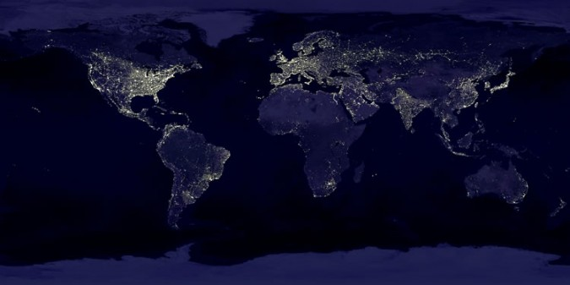
Why sustainability at all?

Slide 3
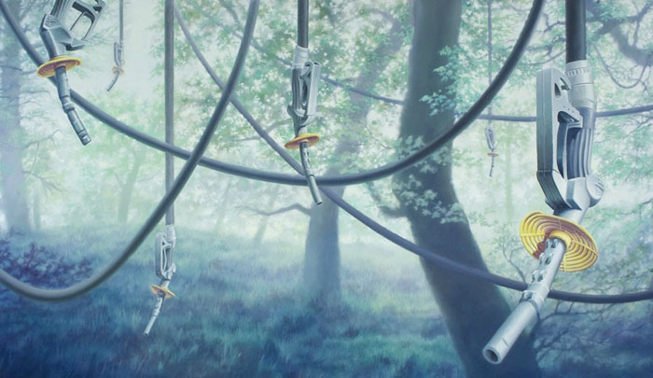
Most Significant Challenge: THE WEB
Matthew Quick
Notes:
MTBE as a fuel additive
Air Regs versus Solid waste

Slide 4
Tawakoni Spill
Environmental Impacts from Largest MTBE Release in History
Joseph E. Odencrantz, TriS
Environmental, Sensible Strategies and Solutions for the Environment
“A gasoline pipeline owned by Explorer Pipeline Company ruptured leaking methyl tertiary butyl ether (MTBE), a gasoline additive, into a creek and lake that the city of Dallas used as a water source. Because of the contamination, the city had to build a pipeline (nine feet diameter, over two and three-quarters of a mile in length and built in three months) to another lake, at a cost of about $9 million.”

Slide 5
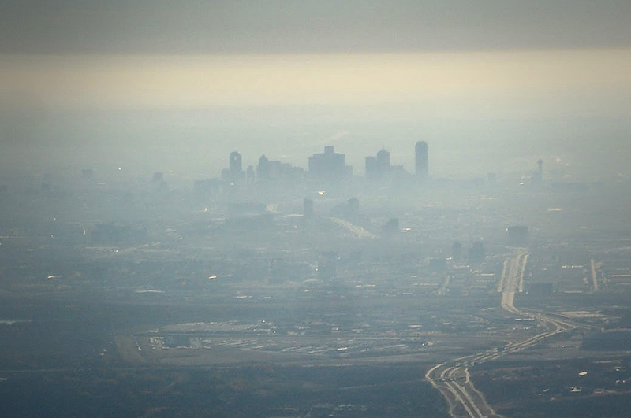
Sustainable?

Slide 6
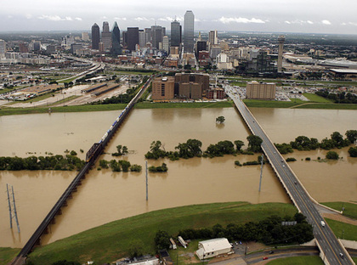
Built (over) Environment

Slide 7
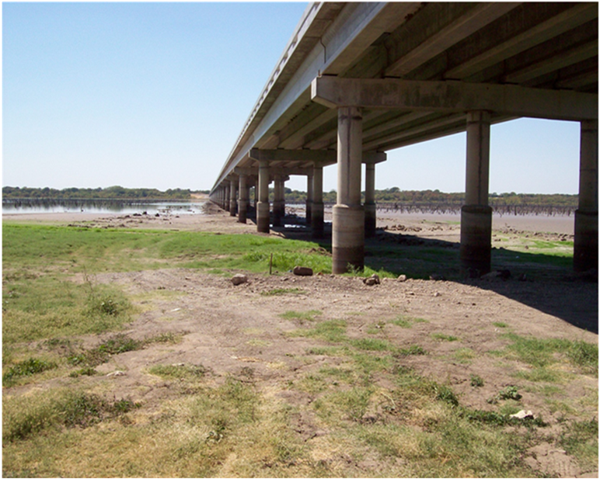
Lake Lavon 2011

Slide 8

Iroquois Confederation
In all our deliberations we must be mindful of the impact of our decisions on the seven generations to follow ours.

Slide 9
Bruntland Commission - 1987
"Sustainable development is development that meets the needs of the present without compromising the ability of future generations to meet their own needs. It contains within it two key concepts:
the concept of needs, in particular the essential needs of the world's poor, to which overriding priority should be given; and
the idea of limitations imposed by the state of technology and social organization on the environment's ability to meet present and future needs."

Slide 10
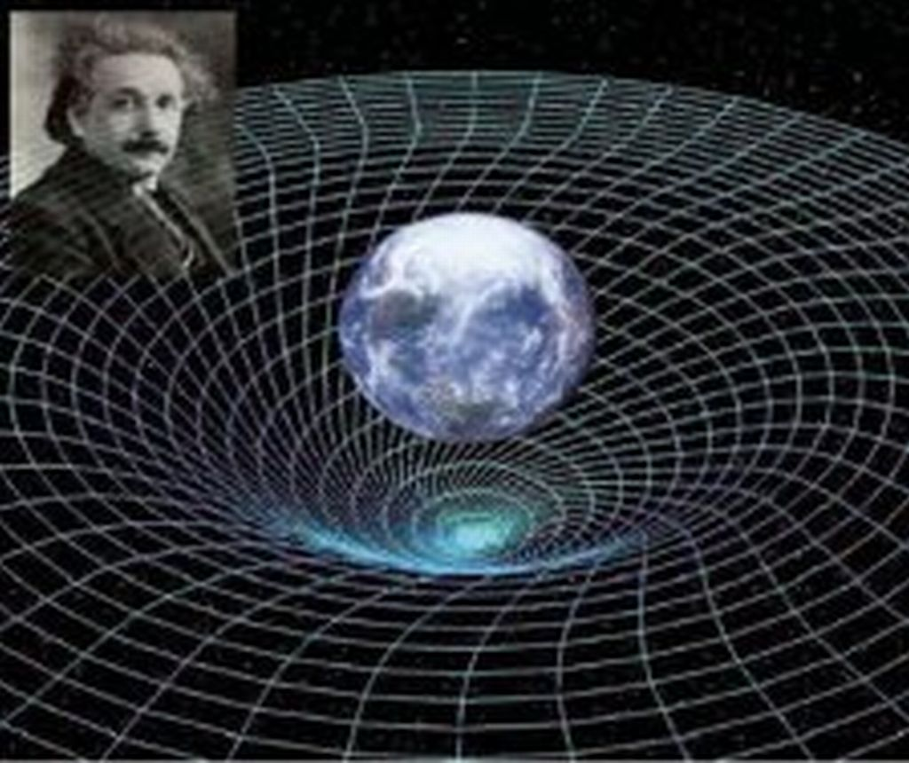
IISD
All definitions of sustainable development require that we see the world as a system—a system that connects space; and a system that connects time.

Slide 11
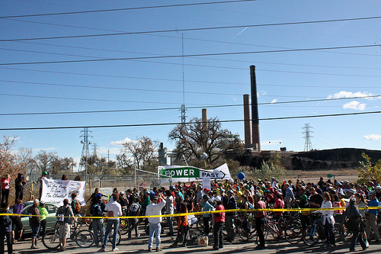
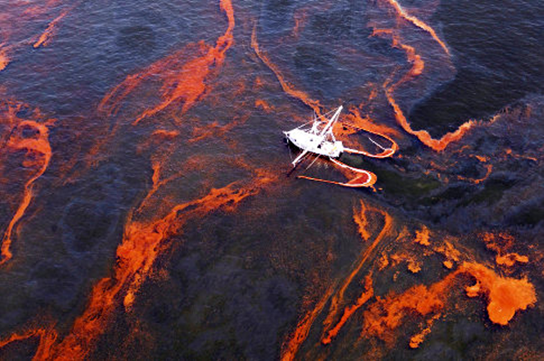
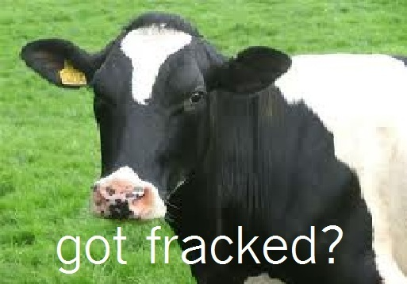
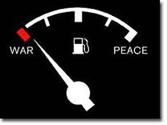
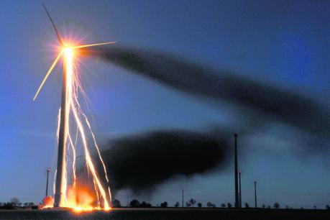
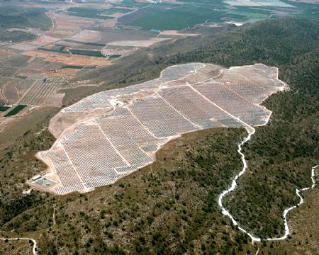

Slide 12
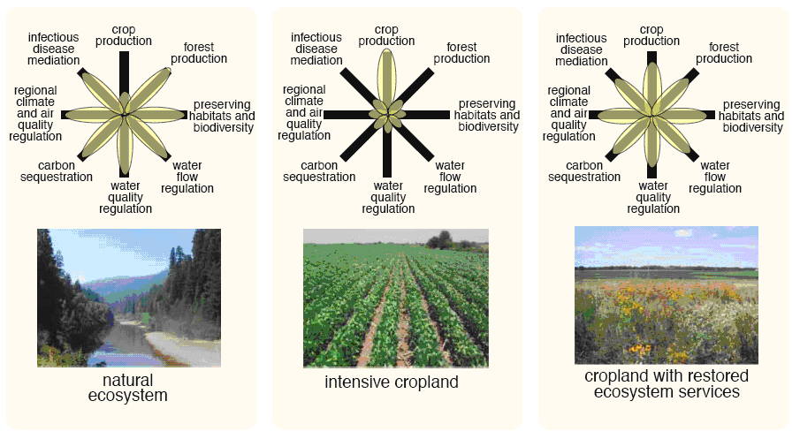
Nature + Creativity = Sustainability
EPA Website; Foley et al, 2005.

Slide 13
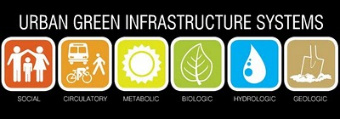
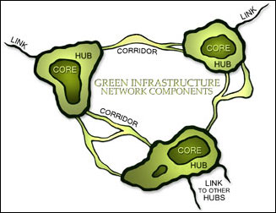

Who? Civil Engineers
Notes:
Most influence in how our cities are built.

Slide 14
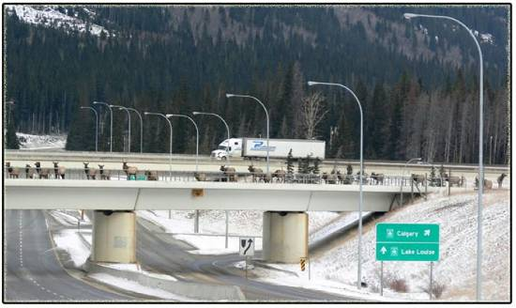
Elk Bridge – Alberta, Canada

Slide 15
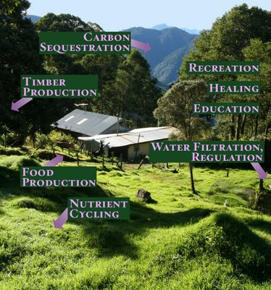
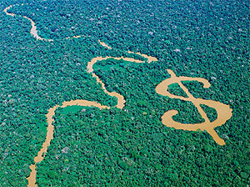
How? Employ Ecosystem Services

Slide 16
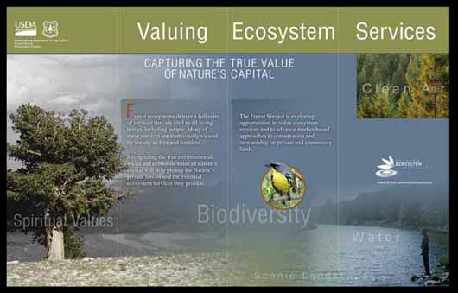
US Forest Service

Slide 17
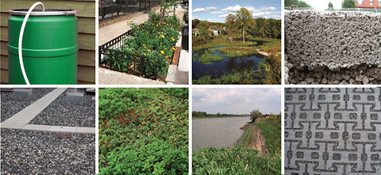
Simplicity

Slide 18
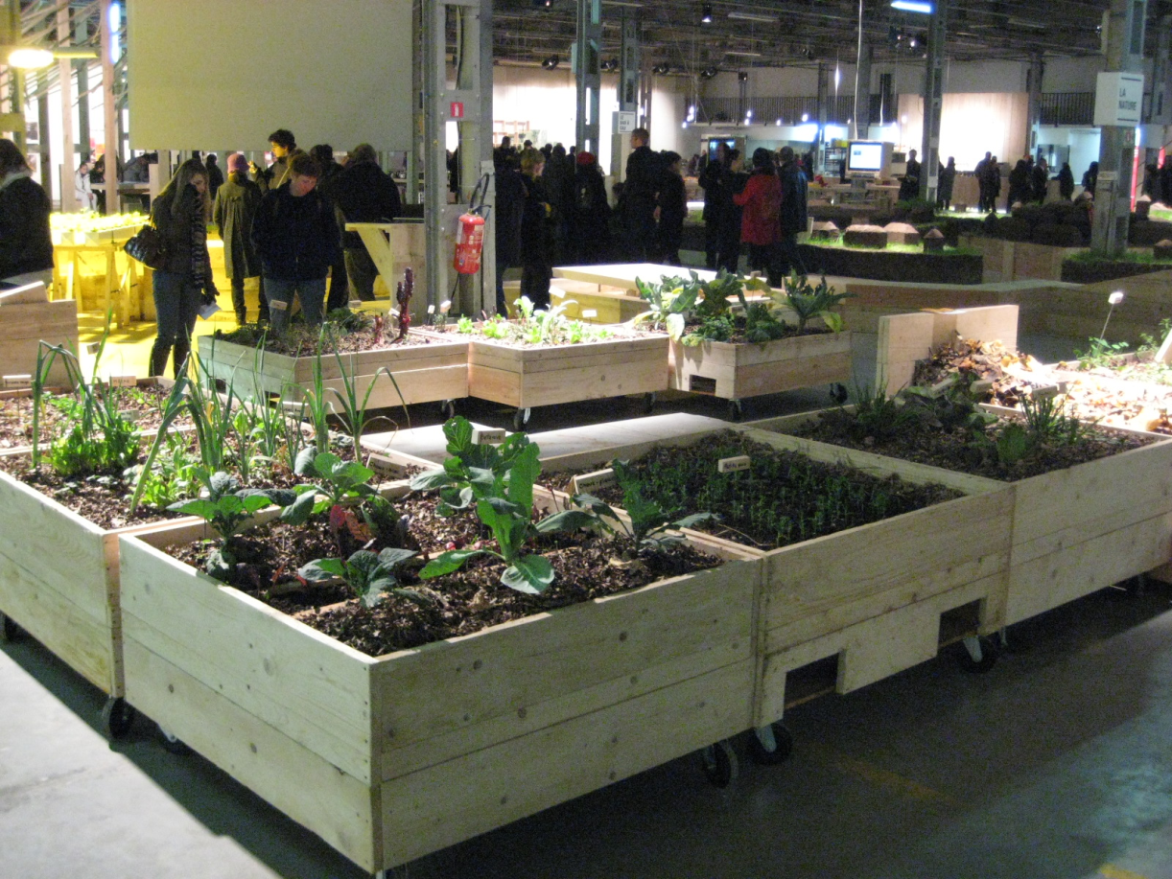
St Etienne, France
Mathieu-Benoit-Gonin's installation on urban permaculture

Slide 19
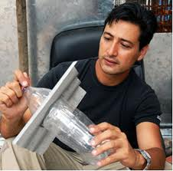
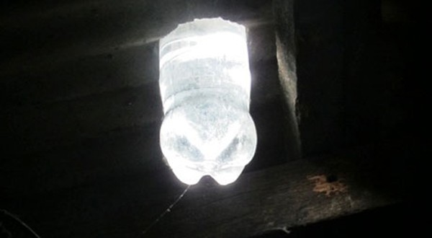
Video Links
Philippines – 55 watts

Slide 20
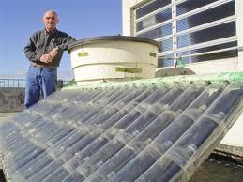
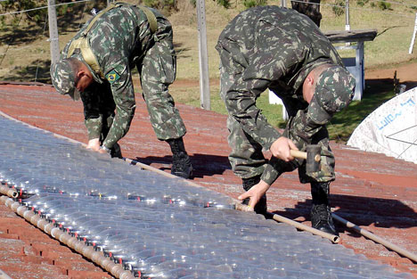
Video Links
Largest Water Solar Heater with PET Bottles Installed
Parana, Brazil

Slide 21
